Slide 1
Use Case
Situation
Customers want to make claims anywhere and whenever they have time without filling out a form.
Insurance company want to automate the processes with low costs.
Available everywhere and at any time
Fast and efficient (e.g. data check, insurance policy number)
Automation (small claims can be processed automatically)
The customer consultant get the relevant cases he is expert in
Employees have more time for complex claims

Slide 2

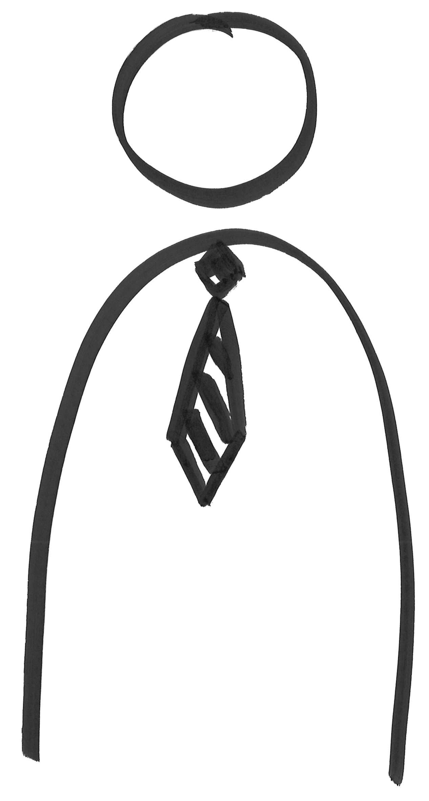


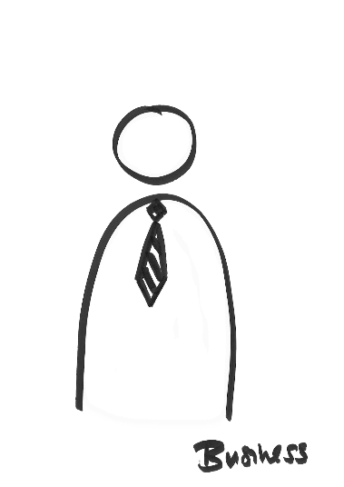
Solution
Solution
Claim
App
Claim

